Slide 1

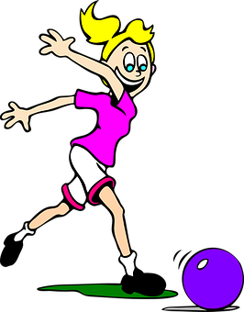
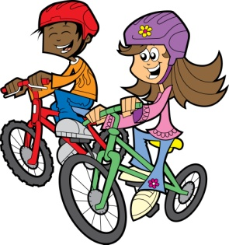
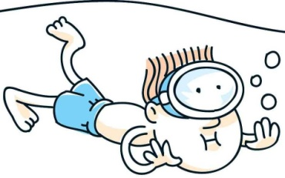
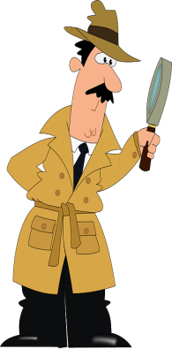
French Year 3, Summer 1
Sport and Opinions
Le Sport [masculine] Sports
le football | football
le rugby | rugby
le tennis | tennis
le badminton | badminton
le golf | golf
le ski | skiing
le basket | basketball
le hockey | hockey
le judo | judo
le ping-pong | table tennis
le skate | skateboarding
le roller | roller skating
le snooker | snooker
le cyclisme | cycling
l’athlétisme | athletics
Key Question
Quel sport aimes-tu? J’aime … | Which sport do you like? -I like…
Les Opinions Opinions
J’aime | I like
J’adore | I love
mais | but
Je n’aime pas | I don’t like
Je déteste | I hate
Le Sport [feminine] Sports
la danse | dancing
la natation | swimming
la gymnastique | gymnastics
l’équitation | horse riding
Quel sport aimes-tu?
J’aime
le football
Important!
In opinion phrases in French, you must use the article ‘the’ [le/la/l’] in front of the sport. Example: J’aime le golf I like [the] golf
Je n’aime pas la natation
J’adore
le cyclisme
KEY SOUND
é | ay
Les Nombres – Numbers
10 Dix | 20 Vingt | 30 Trente

