Slide 1
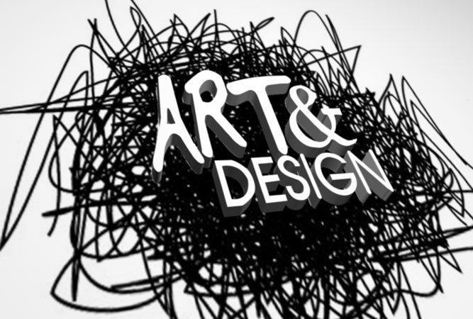
Flashback in Four

Slide 2
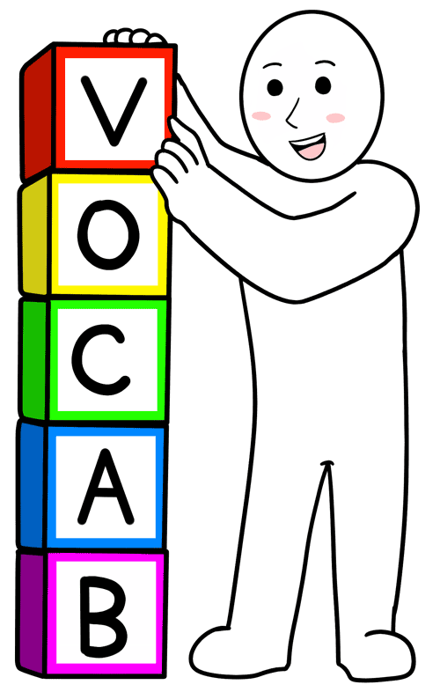
Week 1 Flashback
Word of the Week
Design:
The design process involves developing a design proposal related to the product specification within a design brief.

Slide 3
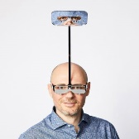
Week 1: Artwork of the Week
If you could ask the designer a question, what would you ask him?
‘One Foot Taller’ glasses (2018) by British artist and designer Dominic Wilcox.

Slide 4
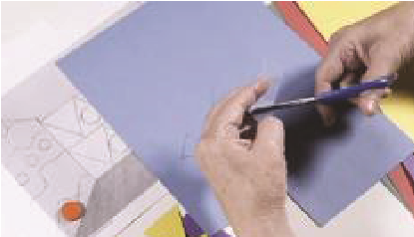
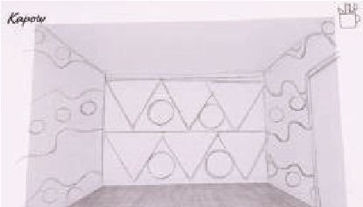
Week 1: Technique of the Week
https://www.kapowprimary.com/subjects/art-design/upper-key-stage-2/year-5/design-for-a-purpose/lesson-2-designing-spaces/
https://www.kapowprimary.com/subjects/art-design/upper-key-stage-2/year-5/design-for-a-purpose/lesson-3-changing-spaces/
Can you use drawing to explore your design ideas for an empty space?
Can you add detail to your design by cutting out and adding shapes and drawing on your design?

Slide 5
Week 2 Flashback
Word of the Week
Prototype:
A prototype is an early model of a product built to test an idea.

Slide 6
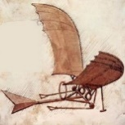
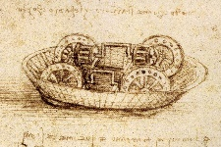
Week 2: Artwork of the Week
What do you think da Vinci was designing in each of these drawings?
Italian artist and engineer Leonardo da Vinci (1452-1519) invented objects hundreds of years ago which could not be made then, but, with advances in technology, have since been realised.

Slide 7
Week 2: Technique of the Week
https://www.kapowprimary.com/subjects/art-design/upper-key-stage-2/year-5/design-for-a-purpose/lesson-1-coat-of-arms/
Can you design a coat of arms by selecting and placing symbols, which represent a person, appropriately within a shape?

Slide 8
Week 3 Flashback
Word of the Week
Functionality:
The functionality of a product refers to how well it serves its purpose.

Slide 9
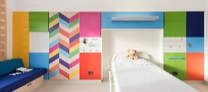
Week 3: Artwork of the Week
How does this space make you feel?
British designers Morag Myerscough and Luke Morgan created bold and bright rooms at a children’s hospital in Sheffield (2017).

Slide 10
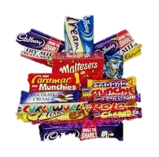
Week 3: Technique of the Week
https://www.kapowprimary.com/subjects/art-design/upper-key-stage-2/year-5/design-for-a-purpose/lesson-4-whats-in-a-name/
Can you work in a team to design and ‘sell’ a product idea?

Slide 11
Week 4 Flashback
Words of the Week
USP:
The unique selling point of a product (or service) is a feature of the product that distinguishes it from other similar products and makes it more appealing.

Slide 12
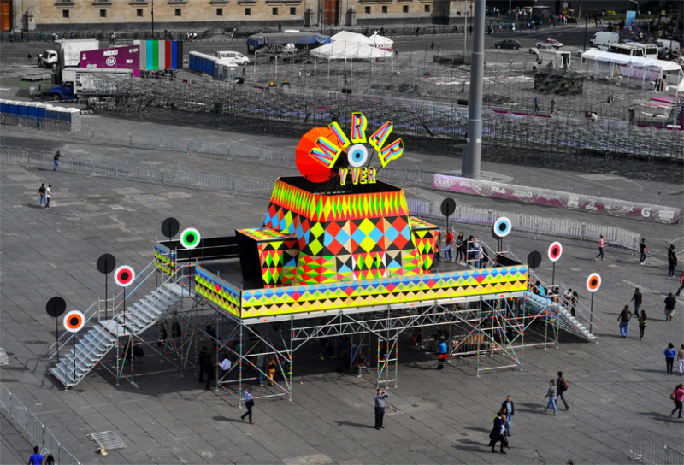
Week 4: Artwork of the Week
If this design was accompanied by music, what would the music sound like?
‘Camera Obscura’ in Mexico City Square by British designers Morag Myerscough and Luke Morgan

Slide 13
Week 4: Technique of the Week
https://www.kapowprimary.com/subjects/art-design/upper-key-stage-2/year-5/design-for-a-purpose/lesson-5-adverts/
Can you talk about how advertising, words, unique selling points and and packaging serve to give a product an identity?

