Slide 1
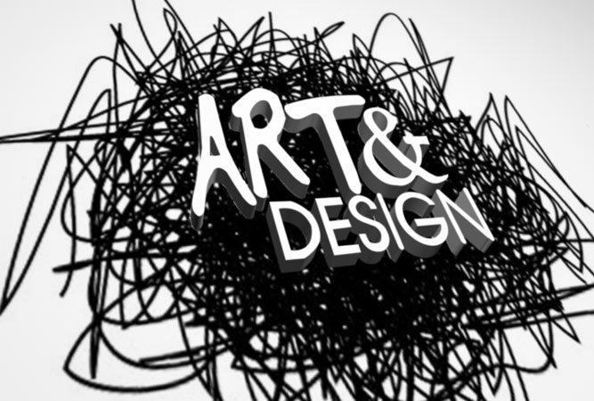
Flashback in Four

Slide 2
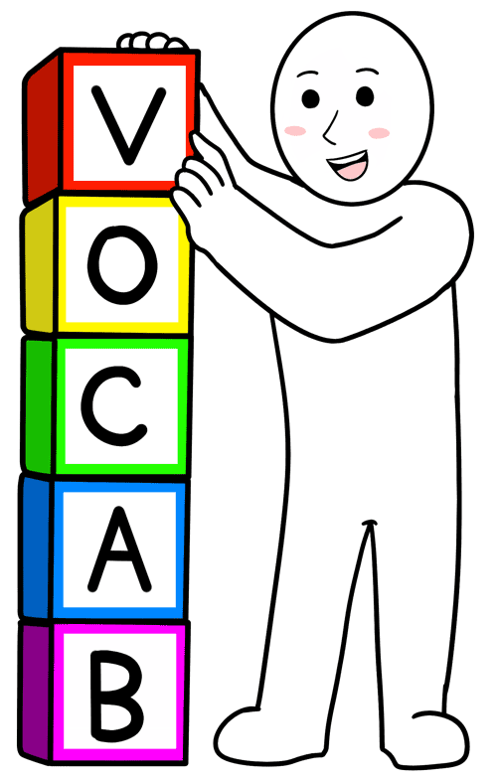
Week 1 Flashback
Word of the Week
Blending Tones:
Blending tones involves applying a small swatch of each tone of colour to a painting, then using a brush to create smooth gradation.

Slide 3
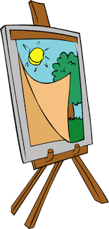
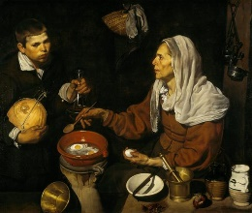
Week 1: Artwork of the Week
What emotions do you notice in the artwork?
What emotions do you feel when looking at this piece?
‘Old Woman Frying Eggs’ (1618) by Spanish artist Diego Velázquez

Slide 4
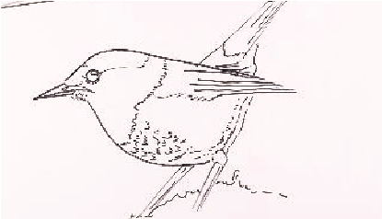
Week 1: Technique of the Week
https://www.kapowprimary.com/subjects/art-design/lower-key-stage-2/year-3/prehistoric-art/lesson-1-exploring-prehistoric-art/
Can you create a proportionate drawing of an animal in the style of prehistoric man-made art?

Slide 5
Week 2 Flashback
Word of the Week
Layering:
Working in layers is a system for creating paintings that involves the use of more than one layer of paint.

Slide 6
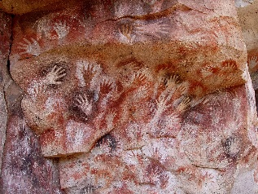
Week 2: Artwork of the Week
If you could ask this artwork a question, what would you ask it?
‘Cueva de las Manos’ (5000BC)

Slide 7
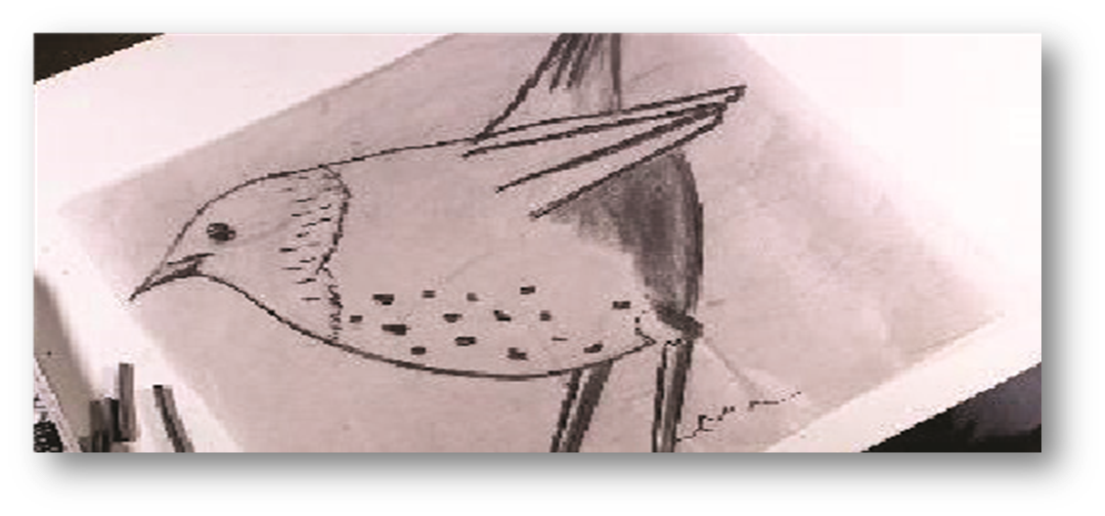
Week 2: Technique of the Week
https://www.kapowprimary.com/subjects/art-design/lower-key-stage-2/year-3/prehistoric-art/lesson-2-charcoal-animals/
Can you scale up your drawing using a different medium, identifying key 2D shapes within the image and applying and blending charcoal to create tone and texture?

Slide 8
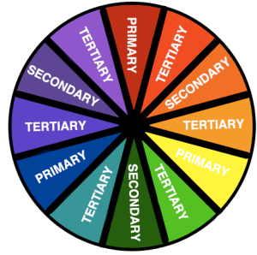
Week 3 Flashback
Word of the Week
Tertiary Colours:
Tertiary colours are produced by mixing equal amounts of a primary colour with a secondary colour adjacent to it on the colour wheel.

Slide 9
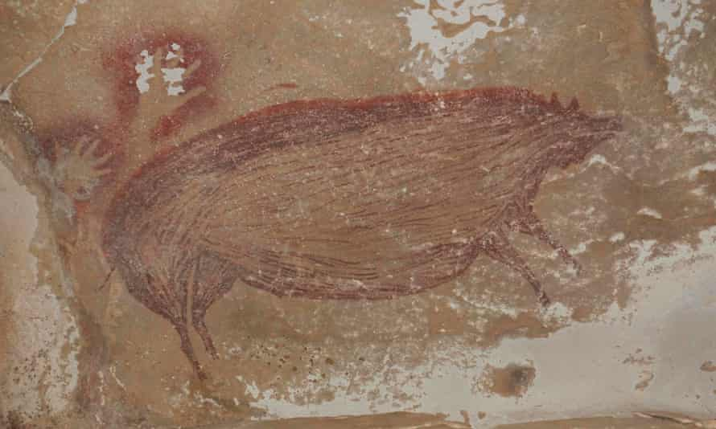
Week 3: Artwork of the Week
Do you think that this piece was intended to be a work of art? Why or why not?
The world's oldest known cave painting, created at least 45,500 years ago, was found in the Leang Tedongnge cave in Indonesia

Slide 10
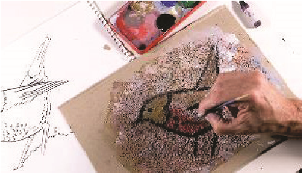
Week 3: Technique of the Week
https://www.kapowprimary.com/subjects/art-design/lower-key-stage-2/year-3/prehistoric-art/lesson-4-painting-on-the-cave-wall/
Can you create a painting from your drawing by mixing paint to create a range of natural colours and experimenting with natural materials to create different textures?

Slide 11
Week 4 Flashback
Words of the Week
Complementary Colours:
Complementary colours are two colours that are on opposite sides of the colour wheel.

Slide 12
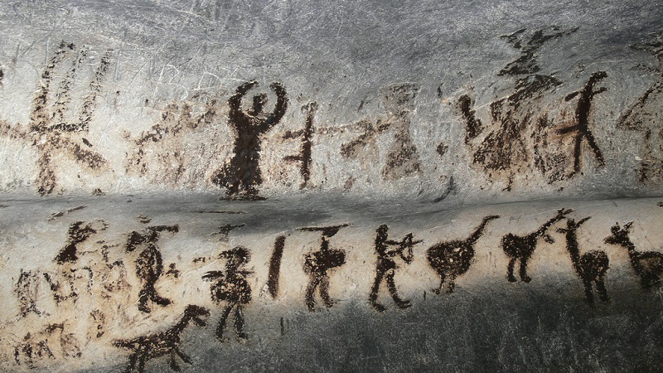
Week 4: Artwork of the Week
What title would you give this artwork?
The prehistoric cave paintings in the Magura Cave in Bulgaria date back around 8000 to 4000 years ago.

Slide 13
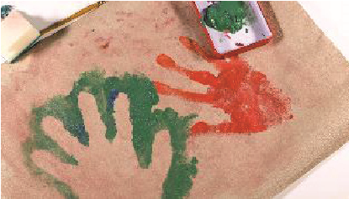
Week 4: Technique of the Week
Space (Positive and Negative):
Positive space refers to the main focus of a picture.
Negative space refers to the background.
https://www.kapowprimary.com/subjects/art-design/lower-key-stage-2/year-3/prehistoric-art/lesson-5-hands-on-a-cave-wall/
Can you create a collaborative piece of artwork using both positive and negative impressions on a textured background?

